Slide 1




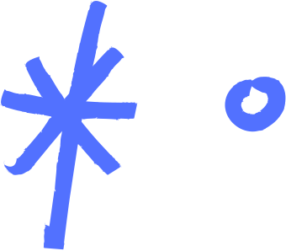

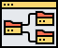

❖ TRAINING DATA AND TEST DATA
❖ SPLITTING DATA, TRAIN SET AND TEST SET
❖ KFOLD CROSS VALIDATION
❖ UNDERFITTING AND OVERFITTING
DROPOUT PROGRAMMER

Slide 2

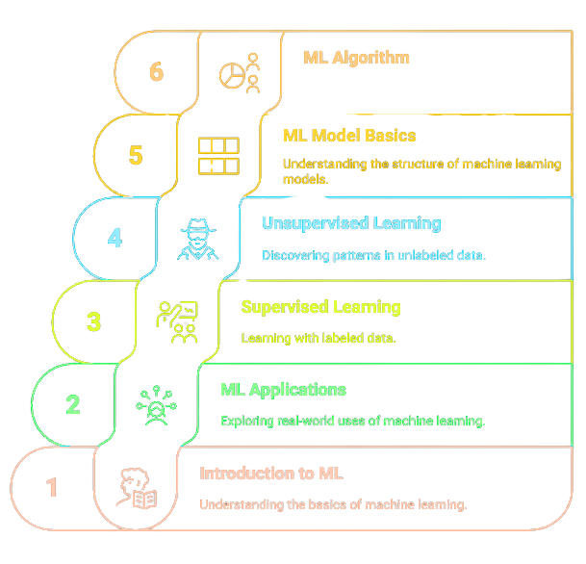
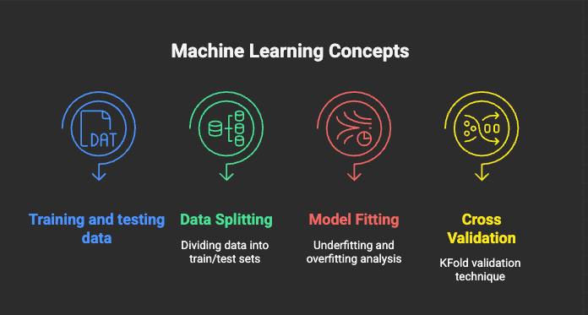

Slide 3
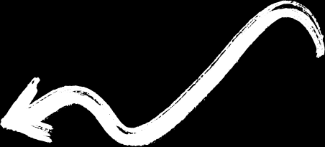
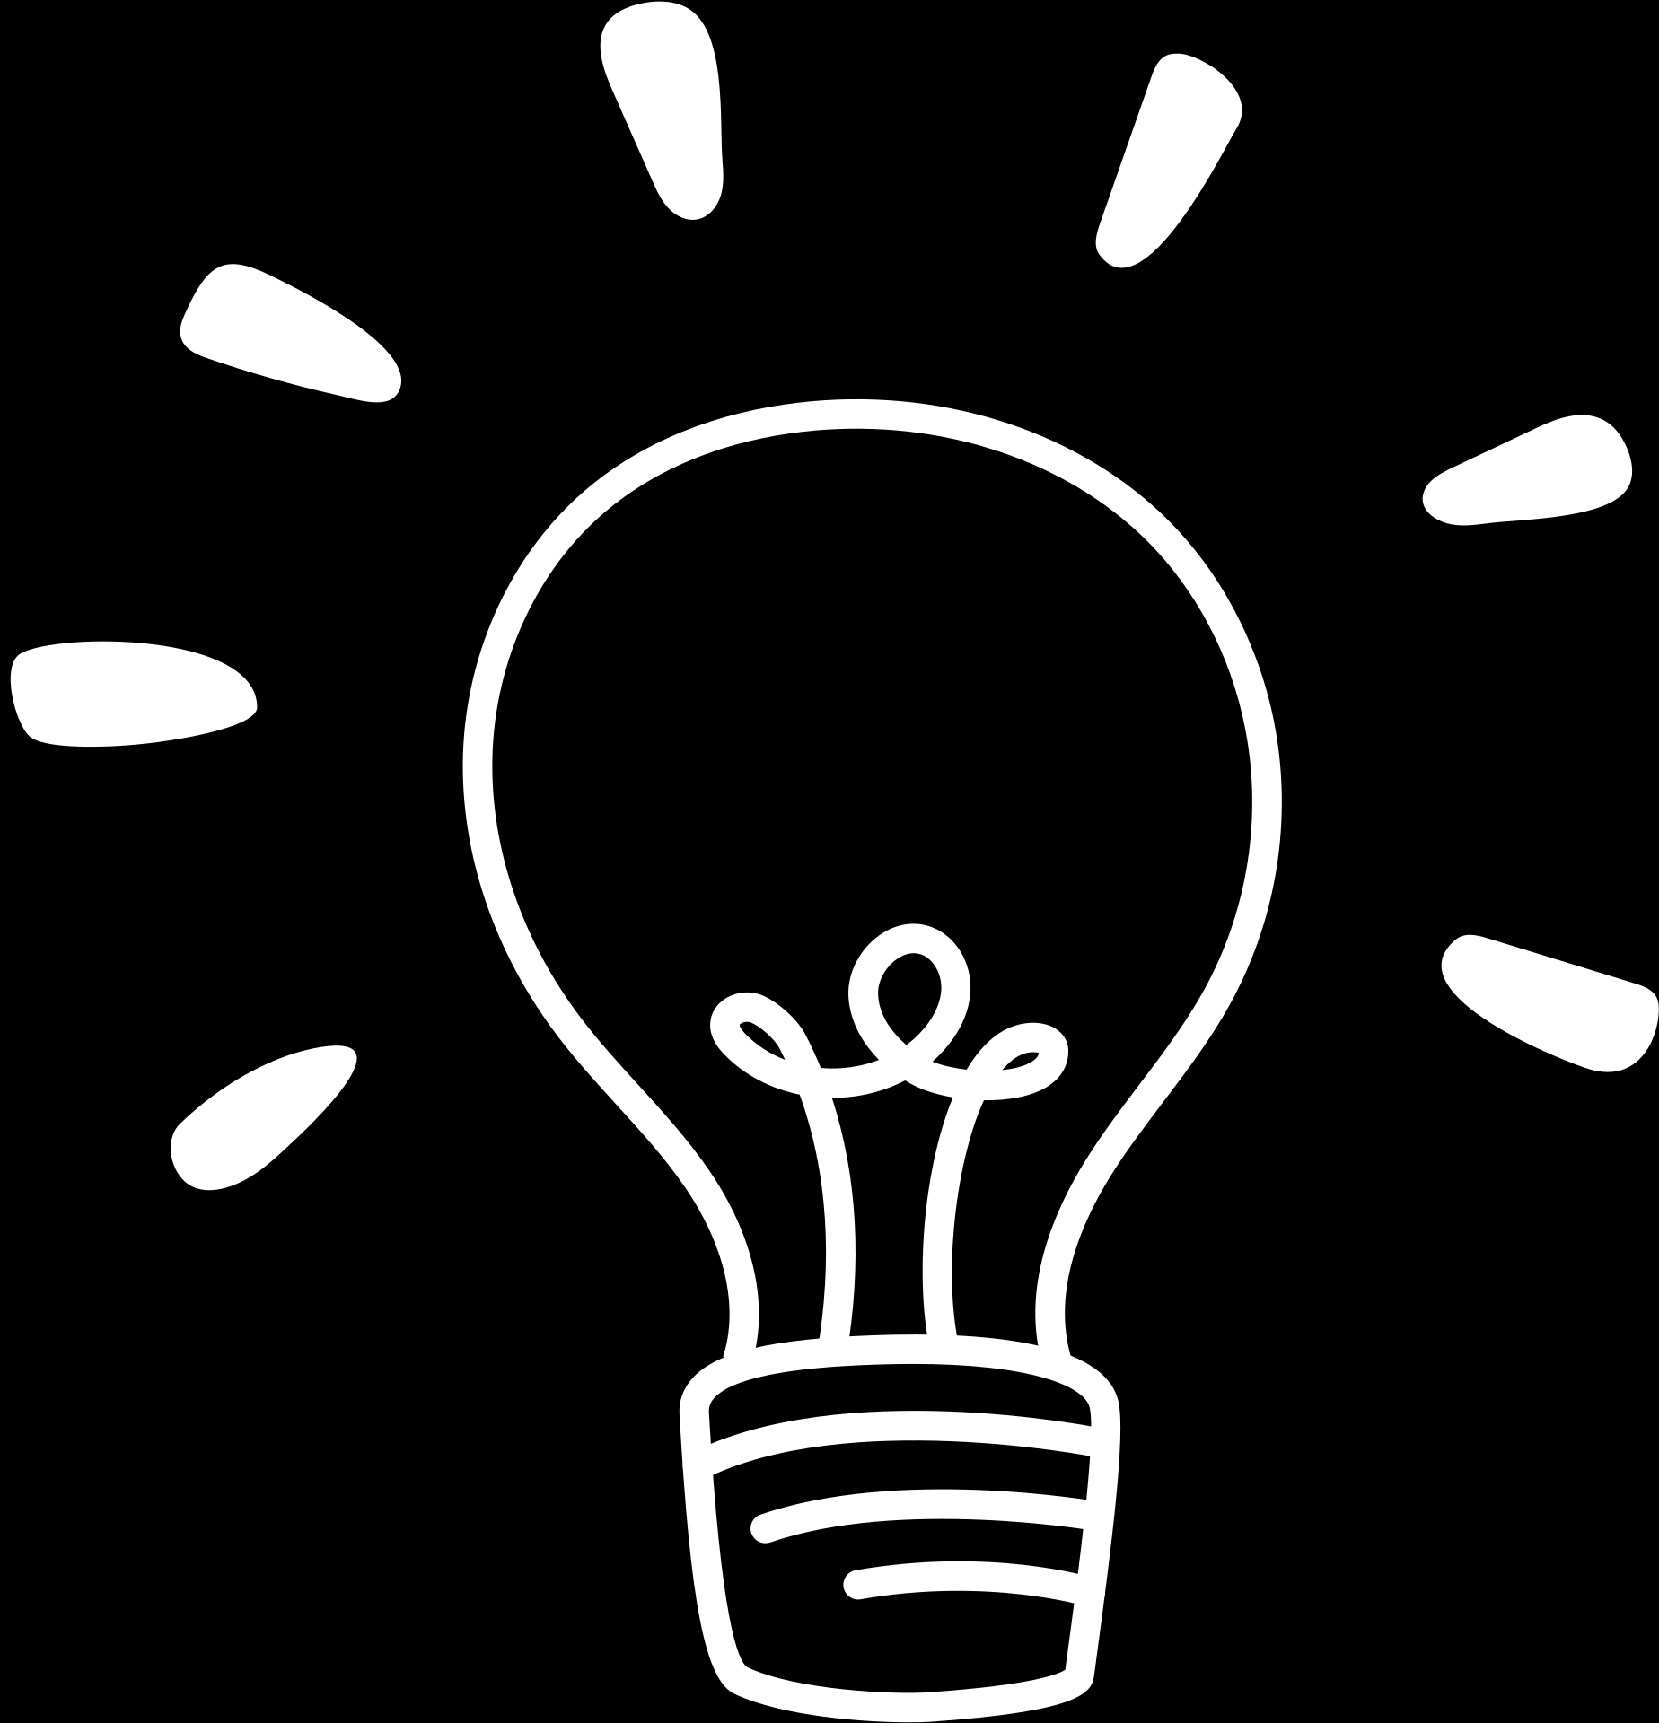

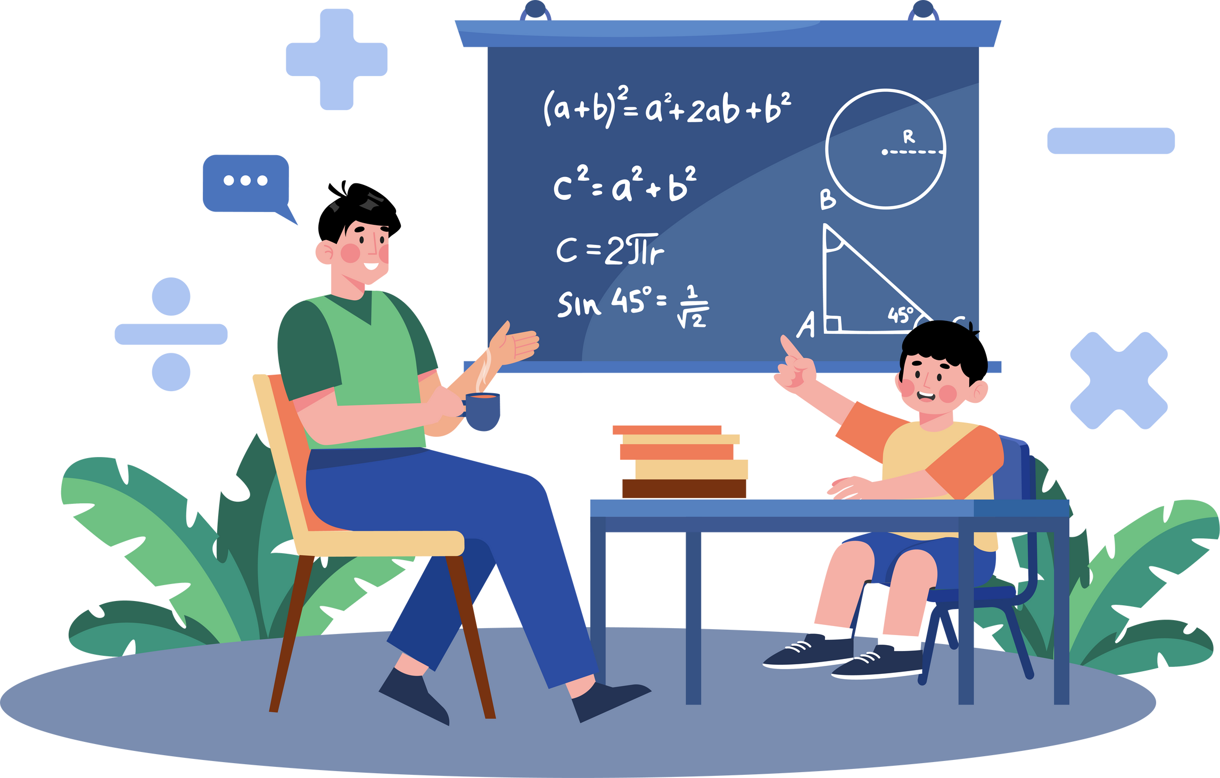
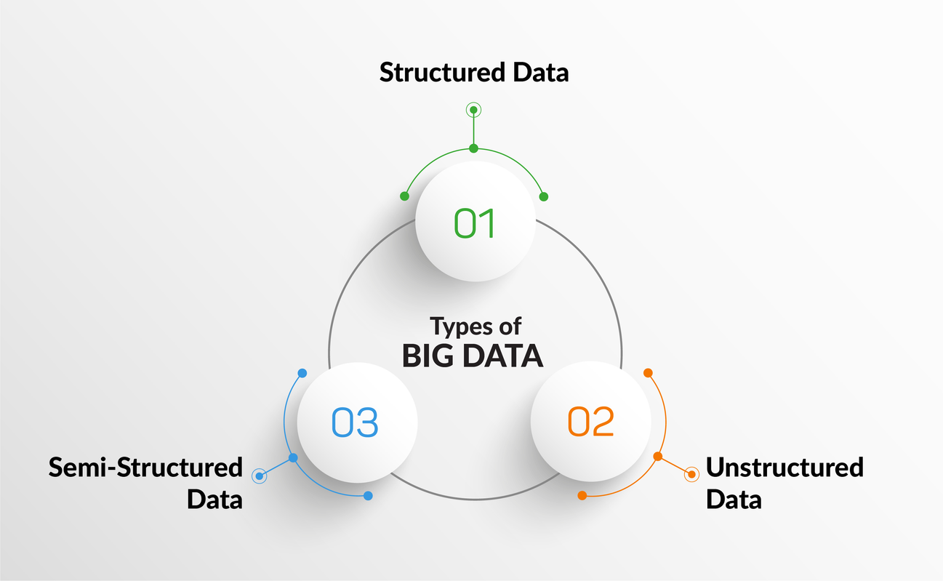
TRAINING DATA AND TEST DATA

Slide 4


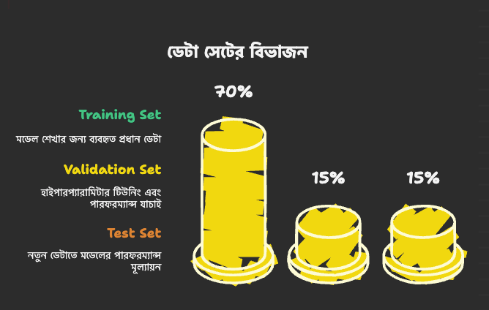
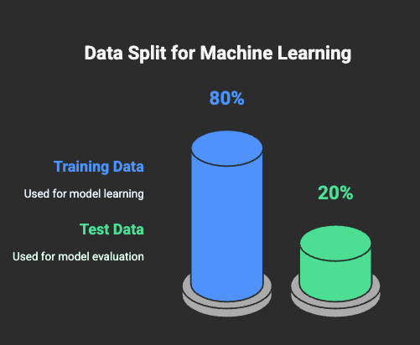
Supervised Learning
FOR SUPERVISED LEARNING

Slide 5
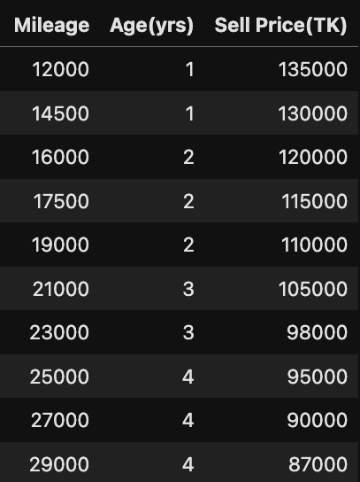
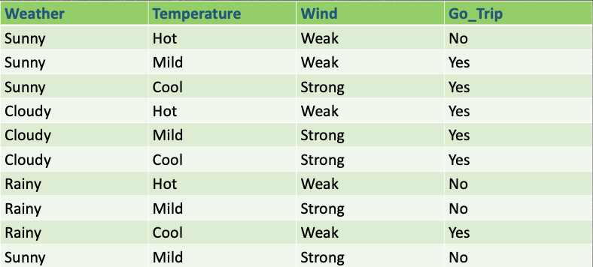
Supervised Learning
FOR SUPERVISED LEARNING

Slide 6
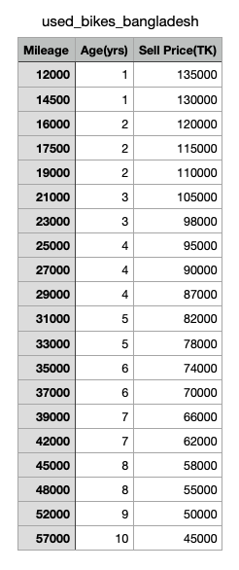
Supervised Learning
K-FOLD CROSS VALIDATION

Slide 7
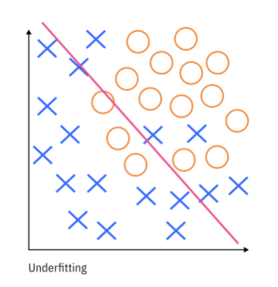
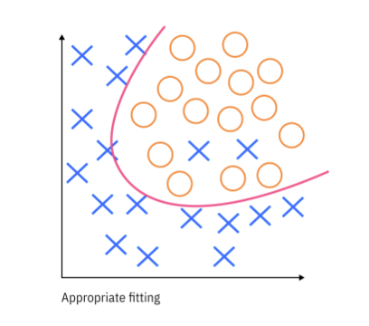
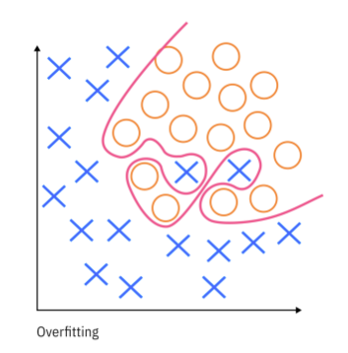
Supervised Learning
UNDERFITTING AND OVERFITTING

Slide 8







Supervised Learning
Hey Robot!
These are balls.
UNDERFITTING
Round shape.

Slide 9



Supervised Learning
UNDERFITTING
It is a Ball
It is a Ball
It is a Ball
It is a Ball

Slide 10
Supervised Learning
OVERFITTING
Round shape.
You can't eat ball.
Ball has stitch.
Ball has 2 or more colors.

Slide 11

Supervised Learning
It is a Ball
OVERFITTING
It is a Ball
It is a Ball
It is not a Ball
It is not a Ball

Slide 12





